Slide 1

Nexthikes IT Solution
User Analytics in
Telecommunication Industry
Data Analytics Project | Data Science with AI
Palvinder Singh

Slide 2

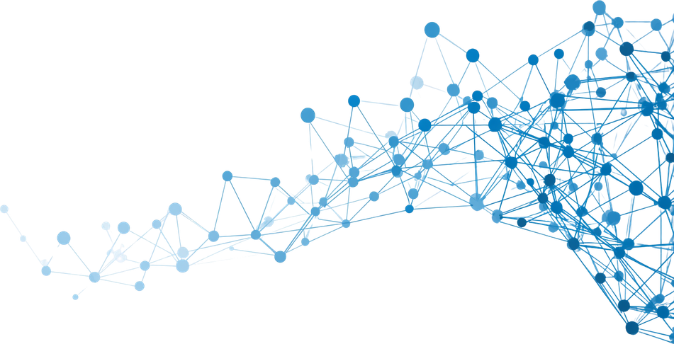
Nexthikes IT Solutions
Agenda
01
Introduction
02
Problem Statement
03
Project Objectives
04
Technologies Used
05
Dataset Overview
06
Data Cleaning
07
Exploratory Data Analysis
08
User Engagement
09
User Experience
10
Business Insights & Conclusion

Slide 3

User Analytics in Telecommunication Industry
Introduction
Telecom companies generate massive volumes of customer usage data every single day. This data encompasses user behavior, handset preferences, session durations, download and upload activity, and network quality metrics.
Analyzing this data is essential to understanding how customers interact with telecom services and infrastructure. Data-driven insights enable providers to proactively address performance bottlenecks and service gaps.
By leveraging advanced analytics, telecom operators can identify patterns in user engagement, segment customers by behavior, and evaluate network performance across regions and device types.
These insights directly drive improvements in service quality, customer satisfaction, and retention — forming the foundation for strategic decision-making and competitive advantage in the modern telecom industry.

Slide 4

Nexthikes IT Solutions
Problem Statement
Understanding Customer Behavior
Telecom companies struggle to interpret vast volumes of customer usage data. Without structured analysis, it is difficult to understand internet usage patterns, session behaviors, and handset preferences that directly influence service quality and customer satisfaction.
Network Performance & Churn Risk
Poor network quality — including high TCP retransmission, latency, and low throughput — negatively impacts user experience and increases churn risk. Data-driven insights are essential to identify problem areas and implement targeted improvements for retention and growth.

Slide 5
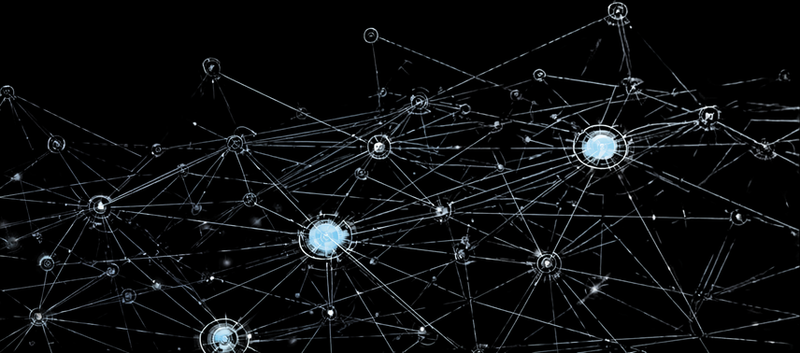
Nexthikes IT Solutions
Project Objectives
User & Handset Analysis
Data Behavior Study
Engagement Metrics
Experience Evaluation
Business Insights
01
02
03
04
05

Slide 6

Savvy Finance
Technologies Used
Language
Data Library
Visualization
Environment
IDE / Tools
Python
Pandas & NumPy
Matplotlib & Seaborn
Jupyter Notebook
VS Code & PowerPoint

Slide 7

Nexthikes IT Solutions
Dataset Overview
Total Records
Total Features
Data Source
Key Features
CSV Dataset, Telecom User Activity Logs
Handset Type, Session Duration, Download/Upload, TCP, RTT, Throughput
150,000
55

Slide 8

Savvy Finance
Data Cleaning
Missing Values
Remove Duplicates
Data Formatting
Validate Accuracy
Preprocessing
Step 1
Step 2
Step 3
Step 4
Step 5

Slide 9

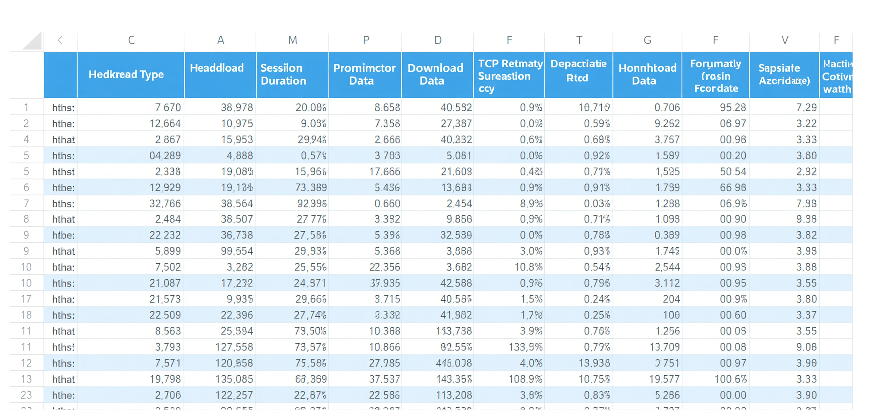
Nexthikes IT Solutions
Dataset Preview
Key Dataset Observations:
• Diverse handset types and manufacturers present across 150,000 user records
• Wide range of session durations and data usage patterns observed
• Initial data quality appears robust with only minor missing values identified
Dataset Highlights:
• 55 features captured per user record including network metrics
• Handset diversity reflects real-world telecom market distribution
• Session and throughput data enables rich engagement analysis
• Minor null values in TCP retransmission and RTT fields — addressed in cleaning phase

Slide 10
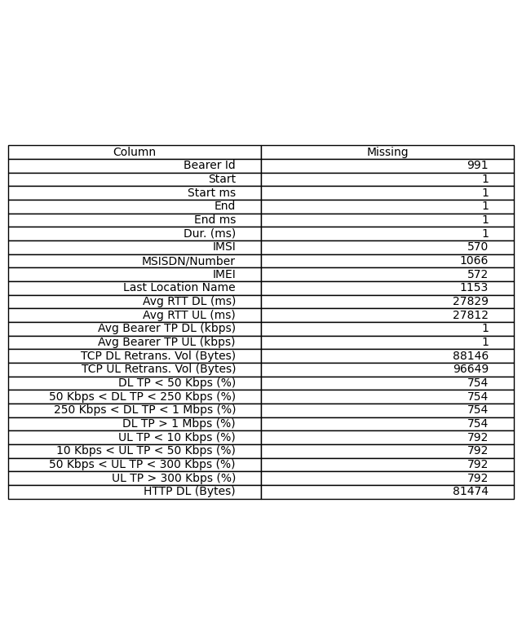
Savvy Finance
Missing Values Analysis
The dataset contained missing values across several key features. Missing data was identified in session duration, TCP retransmission, RTT, and throughput columns.
• Impact: Missing values can skew statistical analysis and reduce model accuracy if not handled properly.
• Strategy: Numerical columns were imputed using median values to minimize outlier influence. Rows with excessive missing entries were removed to ensure data integrity and analysis reliability.

Slide 11
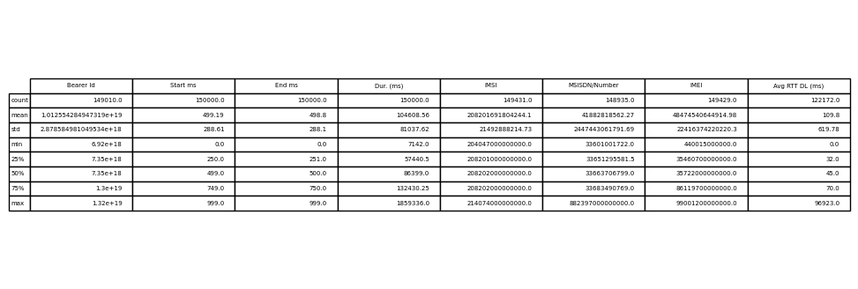
Statistical Summary
Key statistical metrics reveal the distribution and variability of telecom user data across 150,000 records. Mean and median values highlight central tendencies in session duration and data usage, while max/min ranges expose outliers. Standard deviation indicates significant variability in download/upload behavior, reflecting diverse user engagement patterns across the dataset.

Slide 12
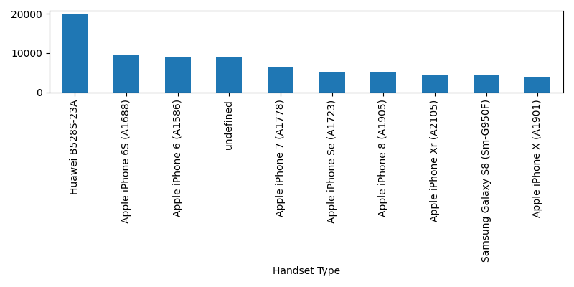
Nexthikes IT Solutions
Analysis of the most popular handset models used across 150,000 telecom users reveals clear market leaders. Apple and Samsung dominate user preferences, with Huawei and other Android manufacturers also holding significant share. These insights help telecom providers tailor network optimization and targeted service offerings to match device-specific usage patterns and customer segments.
Top Handset Types

Slide 13
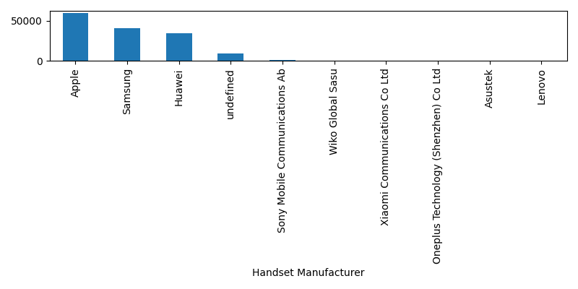
Nexthikes IT Solutions
Top Manufacturers
Analysis of telecom device manufacturers reveals a highly concentrated market. A few dominant brands account for the majority of user devices, with the top manufacturers holding significant market share. Emerging players show gradual penetration, presenting opportunities for targeted partnerships and device-specific service optimization strategies.

Slide 14
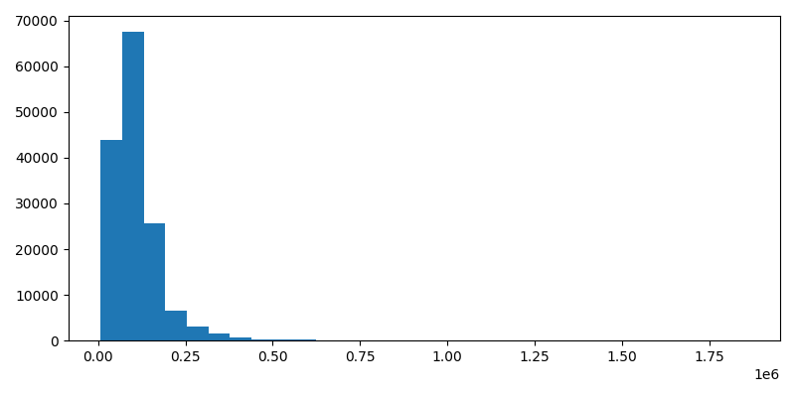
Nexthikes IT Solutions
User Engagement Analysis
Session duration histogram reveals average usage trends.
Download/upload scatter plot shows data consumption patterns.
Peak activity periods identified from engagement metrics.
High data users correlate with longer session durations.

Slide 15
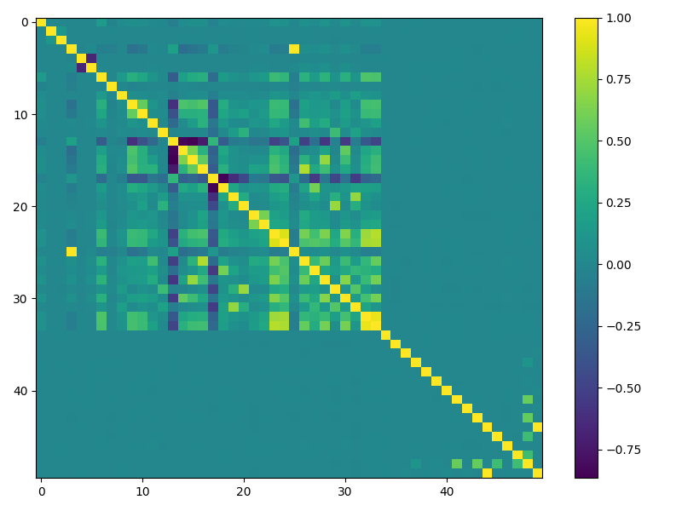
Nexthikes IT Solutions
User Experience Analysis
The correlation heatmap reveals key relationships among network quality metrics. TCP retransmission rates show a strong negative correlation with throughput, indicating that packet loss directly degrades data speeds. RTT (Round Trip Time) correlates positively with retransmission, suggesting latency amplifies network congestion. High throughput is associated with lower RTT, confirming that faster networks deliver better responsiveness. These insights highlight critical areas for network optimization to enhance overall user experience.

Slide 16
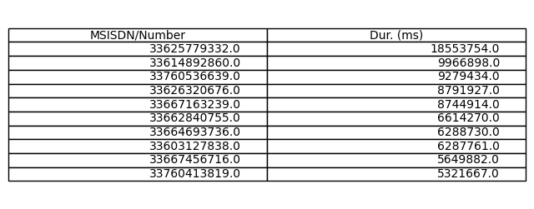
The table highlights the most engaged telecom customers ranked by total activity duration. Top users demonstrate significantly higher session lengths and data consumption, indicating strong network dependency. These high-value customers represent prime targets for loyalty programs, premium service offerings, and personalized retention strategies to reduce churn risk.
Top Active Users

Slide 17
Nexthikes IT Solutions
Business Insights
Customer Segmentation: Distinct user groups identified based on behavior and data usage patterns.
Network Performance: Key areas for quality improvement identified via TCP, RTT & throughput metrics.
01
03
Usage Trends & Recommendations: Peak activity patterns and data-driven strategies for growth and retention.
02
Popular Devices: Handset preferences reveal market trends and inform product offerings.
04

Slide 18

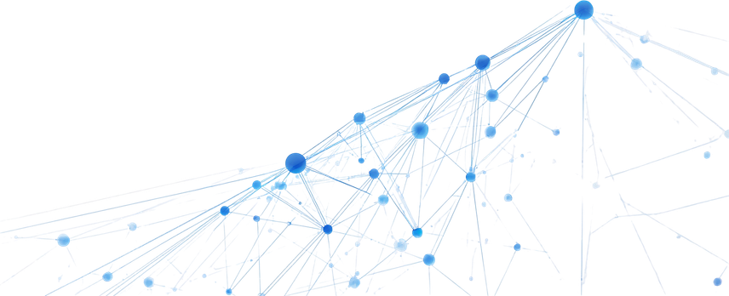
Nexthikes IT Solutions
Future Scope
AI Recommendations
Predictive Analytics
Churn Prediction
Real-Time Dashboards
Cloud & Power BI
AI
ML
CRM
Live
BI

Slide 19

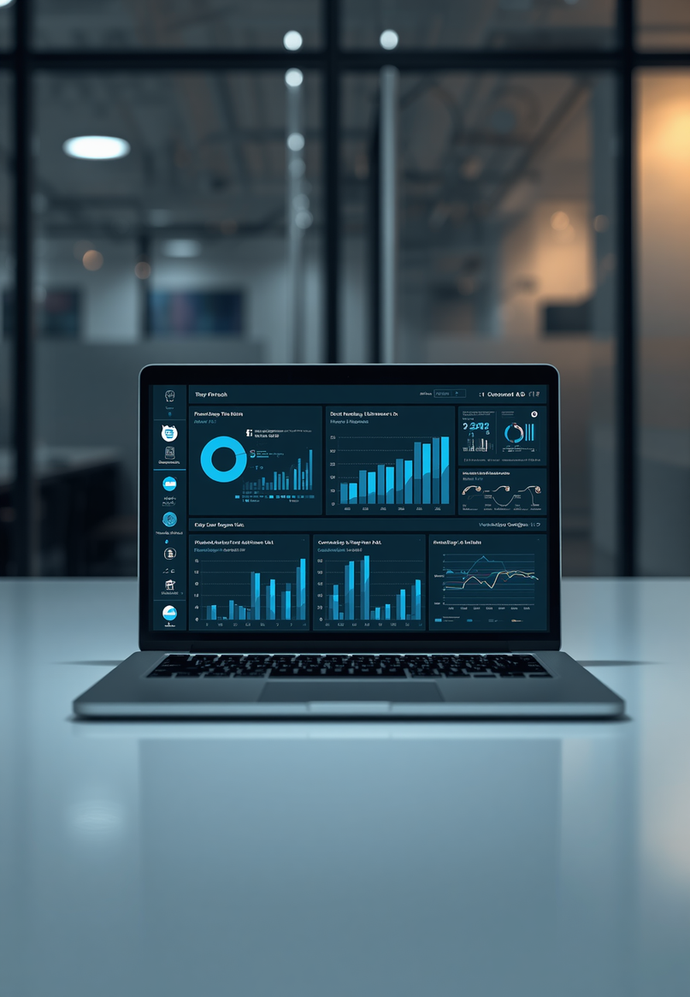
Nexthikes IT Solutions
Conclusion
Comprehensive analysis of telecom customer behavior using Python and data analytics.
Effective data cleaning and visualization techniques successfully applied.
Results support improved customer satisfaction and network optimization.
Foundation laid for future AI and predictive analytics developments.

Slide 20
Nexthikes IT Solutions
Thank You
Questions & Answers
Digicrome Academy | Data Science with AI
palvindersing9999@gmail.com

